Slide 1
Exam Readiness: AWS Certified Developer - Associate

Slide 2
Welcome and Overview

Slide 3
Agenda
The Exam
What to Expect
Domain 1
Deployment
Domain 2
Security
Domain 3
Development with AWS
Domain 4
Refactoring
Domain 5
Monitoring and Troubleshooting

Slide 4
The Exam - What to Expect

Slide 5
Question Allocation
Domain | % of Exam
1: Deployment | 22%
2: Security | 26%
3: Development with AWS | 30%
4: Refactoring | 10%
5: Monitoring and Troubleshooting | 12%
Total | 100%
Questions are multiple choice with single and multiple selections

Slide 6
Today’s Focus
Question Strategy
What to look for in choosing an answer
How to identify key aspects of the question
Content
What to study and key things to know
Practice questions in each domain
Identifying personal gaps
Note: This course is not a substitute for the Developing on AWS course or hands-on experience with AWS
Notes:
This course is designed to provide you with information about the type of content you can expect to see on the exam and strategies for answering questions.
We don’t review specific content in the course; however, we identify suggested content for you to review as part of the exam preparation.
If you detect an unfamiliar term during the course, this signifies that you need to learn more about that concept.
Note: This course is not a substitute for the Developing on AWS course or hands-on experience with AWS.
For more information about the Developing on AWS course, see https://aws.amazon.com/training/course-descriptions/developing.

Slide 7
Today’s Time Allocation
Domain | % of Exam | Presentation Time (mins)
1: Deployment | 22% | 40
2: Security | 26% | 40
3: Development with AWS | 30% | 90
4: Refactoring | 10% | 20
5: Monitoring and Troubleshooting | 12% | 20
Total | 100% | 210

Slide 8
Domain 1 - Deployment

Slide 9
Certification Objectives
Deploy written code in AWS using CI/CD pipelines, processes, and patterns
Deploy applications using AWS Elastic Beanstalk
Prepare the application package to be deployed to AWS
Deploy serverless applications

Slide 10
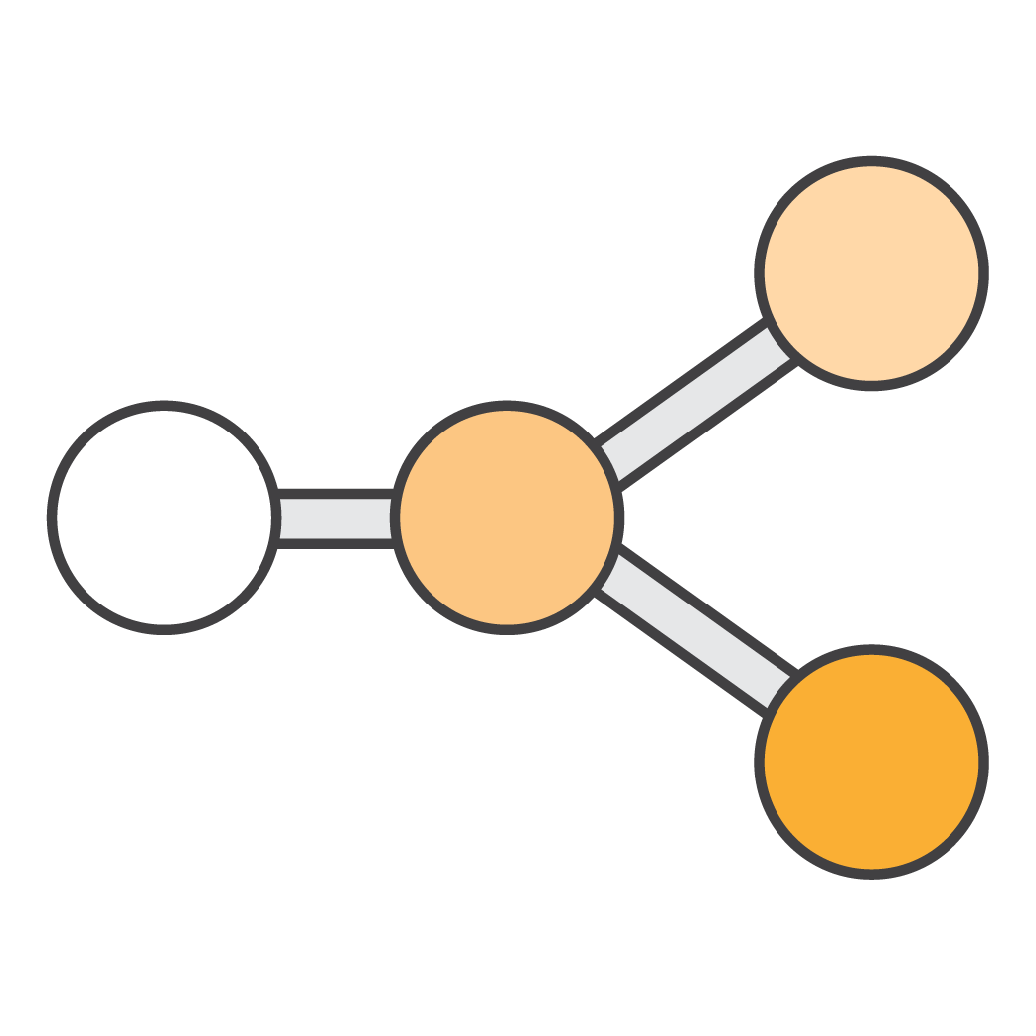




Release Process – Major Phases
Source
Build
Deploy
Test
Monitor
Check-in source code such as Java files
Peer-review new code
Compile code
Unit tests
Style checkers
Code metrics
Create container images
Integration tests with other systems
Load testing
UI tests
Penetration testing
Deployment to production environments
Monitor in production to quickly detect unusual activity or errors
Notes:
Each team’s release process takes a different shape to accommodate its needs.
Nearly all release processes can be simplified to five stages: source, build, test, production, and monitor. Each phase of the process provides increased confidence that the code being made available to customers will work in the intended way.
During the source phase, developers check changes into a source code repository. Many teams require peer feedback on code changes before shipping code into production. Some teams use code reviews to provide peer feedback on the quality of code changes. Others use pair programming as a way to provide real-time, peer feedback.
During the build phase, an application’s source code is built, and the quality of the code is tested on the build machine. The most common types of quality checks are automated tests that don’t require a server to run and can be initiated from a test harness. Some teams extend their quality tests to include code metrics and style checks. There’s an opportunity for automation any time an individual is needed to make a decision on the code.
The goal of the test phase is to perform tests that can’t be done during the build phase and require the software to be deployed to production-like stages. Often, these tests include testing integration with other live systems, load testing, UI testing, and penetration testing. At Amazon, we have many different pre-production stages we deploy to. A common pattern is for engineers to deploy builds to a personal development stage where an engineer can poke and prod their software running in a mini production-like stage to check that their automated tests are working correctly. Teams deploy to pre-production stages where their application interacts with other systems to ensure that the newly changed software works in an integrated environment.
Then, code is deployed to production. Teams have different deployment strategies. We share a goal of reducing risk when deploying new changes and minimizing the impact if a bad change does get out to production.
Finally, the application is monitored to quickly detect unusual activities and errors.
Each stage can be automated without the entire release process being automated.

Slide 11

Understanding CI and CD
Continuous Integration
Source
Build
Deploy
Test
Monitor
Continuous Delivery
Continuous Deployment
Notes:
Continuous Integration
Continuous Integration (CI) is the practice of continuously checking and verifying your code to create change with an automated build and test process. During the past 10 years, CI has gained popularity in the software community. In the past, developers worked in isolation for extended periods of time and attempted to merge their changes in the mainlines of their code only when their features were completed. Batching changes to merge in the mainline made merging the business logic hard and test logic difficult.
CI practices make teams more productive and allow them to develop new features more quickly. CI requires teams to write automated tests which, as we reviewed earlier, improve the quality of the software being released and reduce the time it takes to validate whether the new version of the software is good.
There are different definitions of CI, but the one we hear most about from our customers is when CI stops at the build stage, so we’ll use that definition.
Continuous Delivery
Continuous Delivery extends CI to include testing out to production-like stages and running verification testing against those deployments. Continuous Delivery may extend to a production deployment, but it has some form of manual intervention between a code check-in and when that code is available for customer use.
Continuous Delivery is a step beyond CI because it allows teams to gain a greater level of certainty that its software will work in production.
Continuous Deployment
Continuous Deployment extends Continuous Delivery. It’s the automated release of software to customers from check-in through production without human intervention. Many teams at Amazon Web Services use the Continuous Deployment approach. Continuous Deployment helps customers gain value quickly from the code the team wrote, and the team gets faster feedback on the changes made.

Slide 12

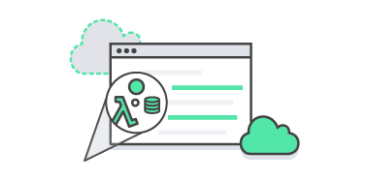

Code Services
AWS CodeCommit
AWS CodeBuild
Customer’s favorite tools
AWS CodeDeploy
AWS X-Ray
Source
Build
Monitor
Test
Production
Amazon CloudWatch
AWS CodePipeline
Notes:
AWS CodePipeline
AWS Code Pipeline is a service for fast and reliable application updates. It allows you to model and visualize your software release process. You can build, test, and deploy your code every time there is a code change, integrating it with third-party tools and AWS.
AWS CodeCommit
AWS CodeCommit is a secure, highly-scalable, managed source control service that hosts private Git repositories. It allows you to privately store and manage assets (such as documents, source code, and binary files) in the cloud.
AWS CodeBuild
AWS CodeBuild compiles source code, runs tests, and produces ready-to-deploy software packages without the need to manage build servers.
AWS CodeDeploy
AWS CodeDeploy automates code deployments to any instance. It handles the complexity of updating your applications, which avoids downtime during application deployment. It deploys to Amazon EC2 -- or on-premises servers -- in any language and on any operating system. It also integrates with third-party tools and AWS.

Slide 13
Sample Question
Which of the following AWS services allows you to automate your build, test and release process every time there is a code change?
Which of the following AWS services allows you to automate your build, test and release process every time there is a code change?
AWS CodeCommit
AWS CodeCommit
AWS CloudFormation
AWS CloudFormation
AWS CodeBuild
AWS CodeBuild
AWS X-Ray
AWS X-Ray
AWS CodePipeline
AWS CodePipeline

Slide 14


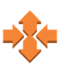


Deploying Highly Available and Scalable Applications
Multiple Availability Zones and multiple Regions
01.
ELB
Health check and failover mechanism
02.
Stateless application – store session state in cache server or DB
03.
Auto Scaling
Application
Application
Application
Application
04.
Understand which service can help you to achieve—for example, Auto Scaling can help you maintain high availability and scalability
DynamoDB
State Information
Notes:
Elastic Load Balancing supports three types of load balancers: Application Load Balancers, Network Load Balancers, and Classic Load Balancers. You select a load balancer based on your application needs.
Application Load Balancer provides advanced request routing targeted at delivery of modern application architectures, including microservices and container-based applications. It simplifies and improves the security of your application by ensuring that the latest SSL/TLS ciphers and protocols are used at all times. Application Load Balancer operates at the request level (Layer 7), routing traffic to its targets: Amazon EC2 instances, containers, and IP addresses based on the content of the request. It’s ideal for advanced load balancing of HTTP and HTTPS traffic.
Network Load Balancer operates at the connection level (Layer 4), routing connections to targets: Amazon EC2 instances, containers, and IP addresses based on IP protocol data. It’s an excellent option for load balancing of TCP traffic because it’s capable of handling millions of requests per second while maintaining ultra-low latencies. Network Load Balancer is optimized to handle sudden and volatile traffic patterns, while using a single static IP address per Availability Zone. It’s integrated with other popular services, such as AWS Auto Scaling, Amazon Elastic Container Service (ECS), and AWS CloudFormation.
Classic Load Balancer provides basic load balancing across multiple Amazon EC2 instances and operates at both the request level and connection level. Classic Load Balancer is intended for applications that were built within the EC2-Classic network. We recommend Application Load Balancer for Layer 7 and Network Load Balancer for Layer 4 when using Amazon Virtual Private Cloud.

Slide 15



Deployment and Maintenance
Deploy code into the cloud
Manage infrastructure
Define the infrastructure
AWS Elastic Beanstalk
AWS OpsWorks
AWS CloudFormation
Notes:
AWS provides several tools to manage your application and resources:
With AWS Elastic Beanstalk, you don’t have to worry about managing the infrastructure for your application. You simply deploy your application, such as a Ruby application, in a Ruby container, and Elastic Beanstalk takes care of scaling and managing it.
AWS Opsworks allows you to manage the lifecycle of your application in layers with Chef recipes. There are out-of-the-box recipes for managing many different types of layers, so you can write custom Chef recipes to manage any layers that are not compatible with AWS.
AWS CloudFormation is infrastructure as code. It is a template-based tool based on JSON or YAML formats. You define templates that identify what infrastructure you want to build out and any relationships that exist among parts of your infrastructure. You could do this manually, but at scale, it would likely require a huge team.

Slide 16

AWS Elastic Beanstalk
Deploy applications without worrying about the details of underlying technologies
Amazon EC2
Web
Application
Package
Components
Environment
Application versions
Configuration
AWS Elastic Beanstalk
Elastic Load Balancing
Auto Scaling
Permission Model
Service role
Instance role
AWS Elastic Beanstalk

Slide 17
AWS Elastic Beanstalk
Focus on building
your application
Your code
HTTP server
Application server
Installed and configured
by AWS
Language interpreter
Operating system
Host
Provided by you
Provided and managed by Elastic Beanstalk

Slide 18
Sample Question
AWS Elastic Beanstalk can create a web server environment with several resources. (Choose four answers.)
AWS Elastic Beanstalk can create a web server environment with several resources. (Choose four answers.)
A. S3 bucket
A. S3 bucket
Load balancer
Load balancer
Auto Scaling group
Auto Scaling group
D. Amazon EC2
D. Amazon EC2
AWS Lambda
AWS Lambda

Slide 19
AWS CloudFormation – Infrastructure as Code
Template
Define resources to create
Code your infrastructure in either JSON and YAML format
AWS CloudFormation
Template
Stack
Stack
Create from templates
Create multiple stacks (in multiple regions) from the same template
Monitor progress of stack updates: in progress, complete, failed (entire stack will roll back).
Notes:
AWS CloudFormation supports most services and features that allow for comprehensive coverage.
You can create infrastructure and loosely-coupled environments or build entire infrastructure, applications, and data for DR and build or teardown use cases.
The AWS CloudFormation template:
Treats it as code and manages it using your choice of version control (for example, Git or SVN).
Defines an entire application stack (all resources required for your application) in a JSON or YAML template file.
Defines runtime parameters for a template (Amazon EC2 instance size, Amazon EC2 key pair, etc.).

Slide 20
Structure of an AWS CloudFormation Template
Other AWS CloudFormation Elements
Intrinsic functions
Pseudo-parameters
Custom resources
Conditional expressions
AWS CloudFormation Template Sections
AWSTemplateFormatVersion: 2010-09-09
Description: template description
Metadata: # template metadata
Parameters: # set of parameters
Mappings: # set of mappings
Conditions: # set of conditions
Resources: # set of resources
Outputs: # set of outputs
Notes:
AWS CloudFormation templates include several major sections, but only the resources section is required. Some sections in a template may be in any order. However, as you build your template, it might be helpful to use logical ordering because values in one section might refer to values from a previous section.
The elements of an AWS CloudFormation template include:
Format Version: Corresponding AWS CloudFormation template version
Description: A text string that explains the purpose of the template
Parameters: Inputs into the template
Mappings: Static variables; key-value pairs
Conditions: Controls for if and when certain resources are created or updated
Resources: AWS assets to create
Outputs: Values of custom resources created by template (URLs, user name, etc.)
For a brief overview of each section of a template, see http://docs.aws.amazon.com/AWSCloudFormation/latest/UserGuide/template-anatomy.html.

Slide 21
Sample Question
Which of the following are valid sections in an AWS CloudFormation template?
(Choose three answers.)
Which of the following are valid sections in an AWS CloudFormation template?
(Choose three answers.)
Parameters
Parameters
Parameters
Services
Services
Outputs
Outputs
Outputs
Declarations
Declarations
Resources
Resources
Resources

Slide 22
Sample Question
Name three built-in functions (intrinsic functions) of AWS CloudFormation that help you manage your stack. (Choose three answers.)
Name three built-in functions (intrinsic functions) of AWS CloudFormation that help you manage your stack. (Choose three answers.)
Ref
Ref
Fn:Join
Fn:Join
C. AWS:Region
C. AWS:Region
Cfn-init
Cfn-init
Fn:GetAZs
Fn:GetAZs

Slide 23
What Is Serverless Computing?
Traditional Deployment and Operations
Serverless Deployment and Operations
Provision an instance
Update OS
Install application platform
Build and deploy applications
Configure Auto Scaling and load balancing
Continuously patch, secure, and monitor servers
Monitor and maintain applications
Provision an instance
Update OS
Install application platform
Build and deploy applications
Configure Auto Scaling and load balancing
Continuously patch, secure, and monitor servers
Monitor and maintain applications
Notes:
Serverless computing allows you to build and run applications and services without thinking about servers. Serverless applications don't require you to provision, scale, and manage any servers, allowing you to build them for nearly any type of application or backend service. Everything required to run and scale your application with high availability is handled for you.
Building serverless applications means your developers can focus on their core products instead of worrying about managing and operating servers or runtimes, either in the cloud or on-premises. This reduced overhead lets developers reclaim time and energy better spent on developing valuable products that scale and are reliable.

Slide 24
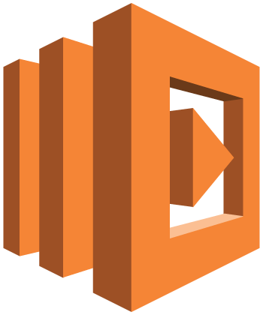

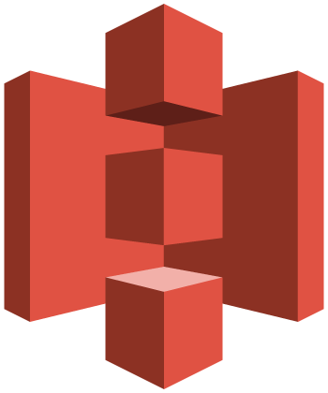
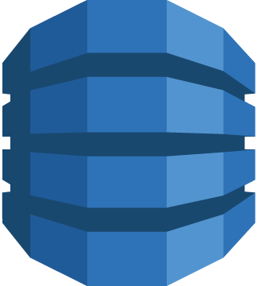






Serverless Platform
Compute
APIProxy
Storage
Database
AWS Lambda
Amazon API Gateway
Amazon S3
Amazon DynamoDB
Interprocess Messaging
Orchestration
Analytics
Developer Tools
Amazon SNS and
Amazon SQS
AWS Step Functions
Amazon Kinesis
Amazon Athena
Tooling
Notes:
To learn more about serverless computing and applications, use this link as a resource: https://aws.amazon.com/serverless/

Slide 25
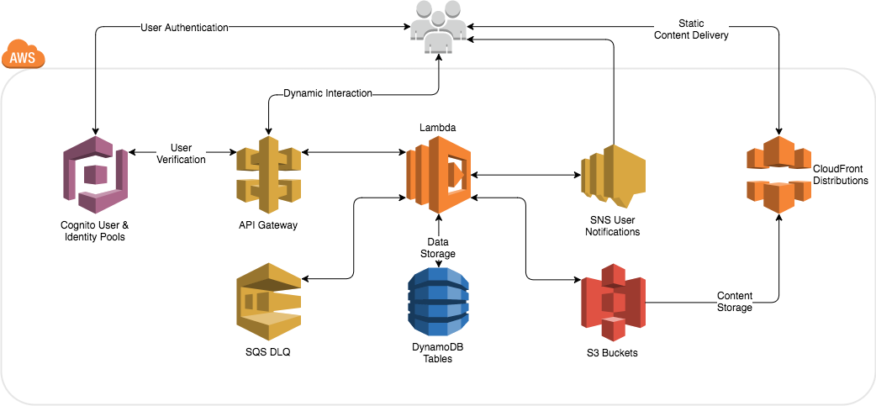
Serverless Architecture
Notes:
To learn more about serverless architecture, use this link as a resource: https://aws.amazon.com/serverless/

Slide 26
AWS Serverless Application Model
AWS CloudFormation extension optimized for serverless
New serverless resource types: functions, API, and tables
Supports anything that AWS CloudFormation supports
Define resources for your serverless application
Open specification (Apache 2.0)

Slide 27
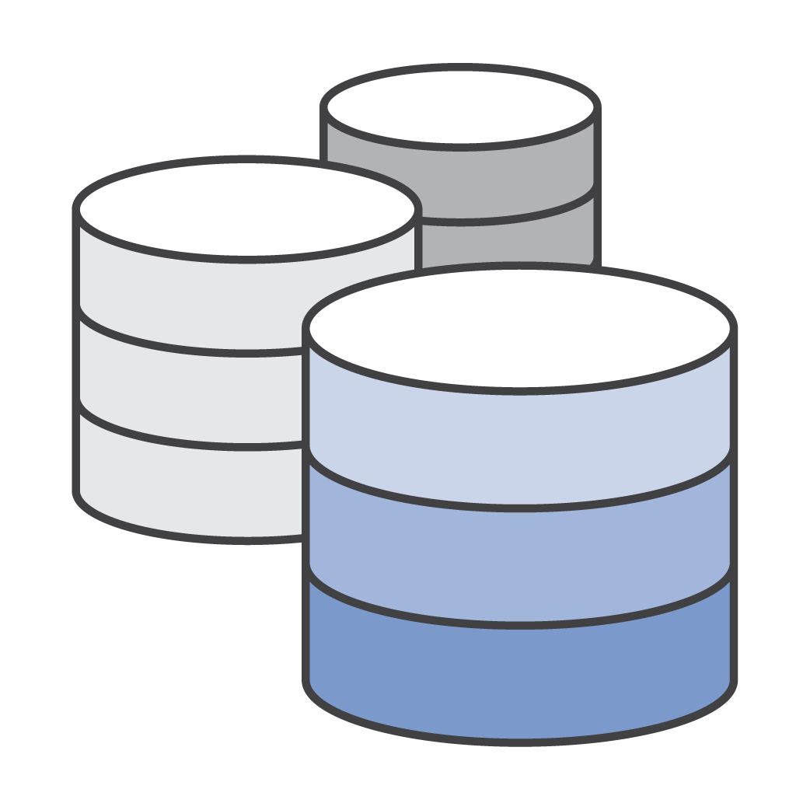




AWS Lambda: Serverless Applications
Event Source
Function
Services
Changes in data state
Node.js
Python
Java
C#
Go
Requests to endpoints
Scheduled events
Notes:
AWS Lambda lets you run code without provisioning or managing servers. You pay only for the compute time you consume. There is no charge when your code is not running.
With Lambda, you can run code for virtually any type of application or backend service with zero administration. Upload your code and Lambda takes care of everything required to run and scale your code with high availability. You can set up your code to automatically trigger from other AWS services or call it directly from any web or mobile app.
We need to take into account a number of different paradigms when doing CI&CD for serverless applications:
Lambda functions are a unit of deployment.
We typically have multiple Lambda functions per application.
Each function will have an event trigger, which could be shared or unique to each function.
A serverless application is typically a combination of Lambda + other AWS services
The next thing to consider is the event source. The event source defines how and when the code that you wrote and want to run will occur. There are a number of different event sources available today, and it’s growing at a very rapid pace.
Each unique event source type defines what data and metadata are passed to your function so that it’s able to process with all the context needed for your application. For example, if you choose Amazon API Gateway as your event source, your Lambda function will receive all of the HTTPS request details it needs to process that API request.

Slide 28

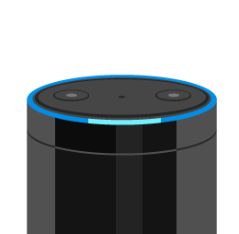
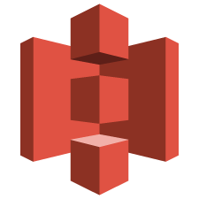
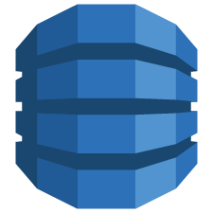








Event Sources That Trigger AWS Lambda
DATA STORES
ENDPOINTS
Amazon S3
Amazon DynamoDB
Amazon Kinesis
Amazon Cognito
Amazon API Gateway
AWS IoT
AWS Step Functions
Amazon Alexa
DEVELOPMENT AND MANAGEMENT TOOLS
EVENT AND MESSAGE SERVICES
AWS CloudFormation
AWS CloudTrail
AWS CodeCommit
Amazon CloudWatch
Amazon SES
Amazon SNS
Cron events
Amazon SQS

Slide 29
Sample Question
How can you deploy a Lambda serverless application? (Choose three answers.)
How can you deploy a Lambda serverless application? (Choose three answers.)
AWS CloudFormation deploy command
AWS CloudFormation deploy command
B. AWS CodeCommit
B. AWS CodeCommit
AWS SAM
AWS SAM
AWS CodeDeploy
AWS CodeDeploy

Slide 30
Test Axioms
Elastic Load Balancing and Auto Scaling are designed to work together
Scaling out is better than scaling up
AWS Elastic Beanstalk allows you to focus on building your application
AWS CloudFormation templates allow you to have a definition of resources to create
A serverless application is typically a combination of Lambda plus other web services

Slide 31
References
AWS Elastic Beanstalk
https://docs.aws.amazon.com/elasticbeanstalk/latest/dg/concepts.html
AWS CloudFormation
https://docs.aws.amazon.com/AWSCloudFormation/latest/UserGuide/Welcome.html
AWS Lambda
https://docs.aws.amazon.com/lambda/latest/dg/deploying-lambda-apps.html
AWS Serverless Application Model
https://github.com/awslabs/serverless-application-model

